Slide 1



Connecting
Commerce
Confidential and in Confidence. Copyright Scurri Web Services Ltd 2019

Slide 2



Agenda
Connecting
Commerce
1
Overview of Scurri
2
About me
3
Transitioning to a Career in Technology – case study

Slide 3






About us
Connecting
Commerce

Slide 4


Connecting
Commerce
Scurri connects and optimises your online ordering, shipping and delivery.
It’s a dynamic platform & API designed to be simple, effective & adaptable to your needs.
Notes:
Key takeaway point: It’s a simple adaptable platform- easy to use and it’s easy to configure. Across the Uk we have over 97% of carrier integrations rolled out!

Slide 5









Connecting Commerce
Connecting
Commerce
Dedicated to connecting you to your customers
€1.76Bn
The GMV that Scurri
Facilitated last year
247
The number of countries which Scurri ships to
93%
Coverage of the UK courier market (by Volume)

Slide 6










How Scurri works
Connecting
Commerce
Carrier 1
Rules engine
Carrier 2
Carrier 2
Carrier 3
Barcode
Label
Parcel
Shopper
Order
Management
System
API
Warehouse
Management
System
API
Barcode
Label

Slide 7

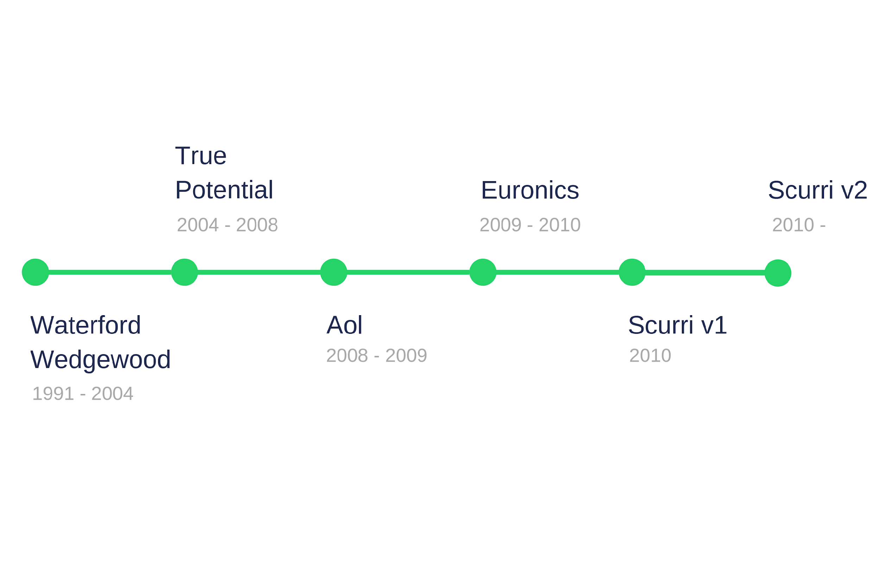
About me
Connecting
Commerce
Possible Solution emerging
Discovery
Scurri Steps
Understand the “Problem”
Make Connection
Solution Presentation
Exact Solution

Slide 8

Case study: Alan Holmes
Technical Support Engineer
Connecting
Commerce
The biggest challenge is retraining correctly
Environment had changed a lot while Alan was studying
In tech the interview process is rigorous and different from most interviews

Slide 9
Connecting
Commerce
Confidential and in Confidence. Copyright Scurri Web Services Ltd 2019

